Slide 1
EEE 202: INTRODUCTION TO ELECTRICAL ENGINEERING
LECTURERS: ENGR A. E. AMORAN
MR ABDULLAHI MOHAMMMED

Slide 2
CONTENTS
Basic AC theory- Periodic wave forms, average instantaneous, peak, mean and RMS values, form
and peak factors , single phase series alternating current circuits and Application of complex numbers
to series AC networks, single phase parallel alternating current (Admittance, conductance and Susceptance) circuits and Application of complex numbers to parallel AC networks, Series and
parallel Resonance, Bandwidth and Q factor, Power in AC circuits and Power factor Correction/improvement,
Delta-star and star-delta transformations
Brief Discussion of vacuum devices: diode, triode, tetrode and pentode, their characteristics and
applications. Elementary treatment of semiconductor devices: PN junction diode, rectifier diodes,
varactor diode, Schottky diode, zener diode, light emitting diode (LED), bipolar junction transistor (BJT), field effect transistor (FET), Thyristors, Integrated Circuits (ICs) etc.

Slide 3
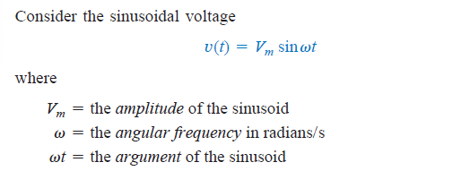
Sinusoids and Phasors
A sinusoid is a signal that has the form of the sine or cosine function.
A sinusoidal current is usually referred to as alternating current (ac). Such a current reverses at regular time intervals and has alternately positive and negative values. Circuits driven by sinusoidal current or voltage sources are called ac circuits
What is a signal - A signal is used for an electrical quantity such as current of a voltage or (electromagnetic wave) when it is used to covey information

Slide 4
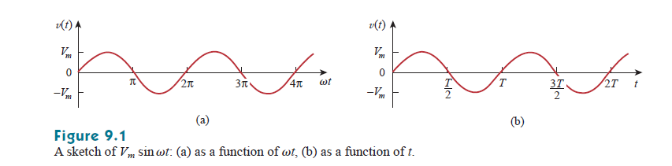
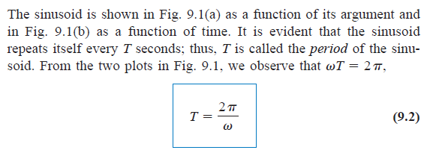
Sinusoids and Phasors
Positive half cycle
Negative half cycle

Slide 5
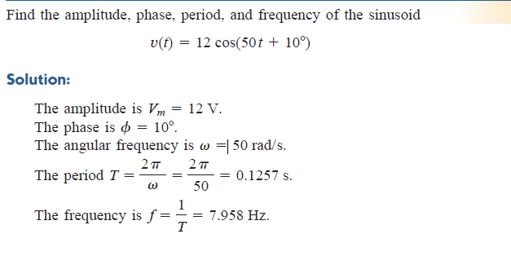

Slide 6
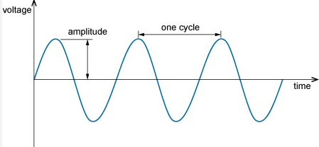
Definition of Terms
1. Wave form: The wave form of an AC quantity is a graph of its magnitude against time. The wave form tells us about instantaneous changes in magnitude of an AC quantity.
2. Cycle: One complete set of positive and negative values of an alternating quantity is known as cycle.
3. Amplitude or Peak value: It is the maximum value (positive or negative) of an alternating quantity.
4. Instantaneous value: It is the value of the alternating quantity at any instant.
5. Time Period (T): It is the time required by an alternating quantity to complete one cycle.
6. Frequency: The number of cycles completed in one second by an alternating quantity is known as its frequency. Its unit is Hertz (Hz). The relation between time period and frequency is given by:
f = 1/T or T =1/f.

Slide 7
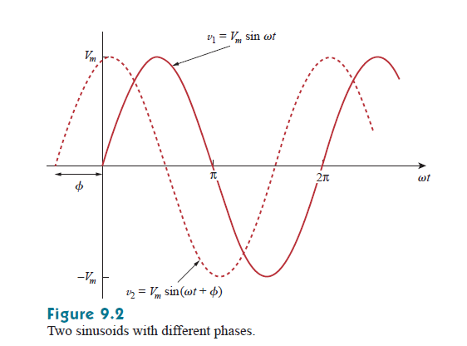
Definition of Terms
8. Phase: It is given by the amount of time (or angle) since the wave last passed through its zero value
9. Phase Difference: The angle difference or time difference between two sine waves since they last passed through their zero value is called phase difference.
10. In-phase: When two sine waves achieve their maximum value or zero value at the same time, they are said to be in phase.
11. Lag and Lead: A sine wave which reaches its zero or maximum value later than the other is called lagging sine wave. Sine wave that reaches its zero value later than the other wave is called leading. Also, it reaches it maximum value later.

Slide 8
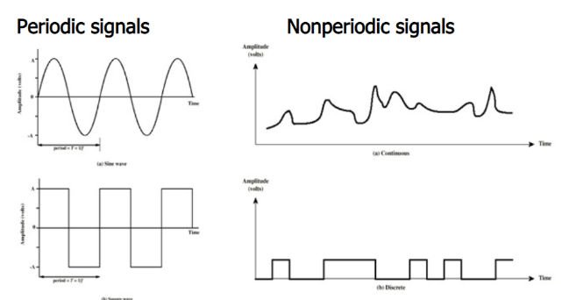
Periodic or non-periodic signal
A signal is said to be periodic signal if it has a definite pattern and repeats itself at a regular interval of time. Whereas, the signal which does not at the regular interval of time is known as an aperiodic signal or non-periodic signal.

Slide 9
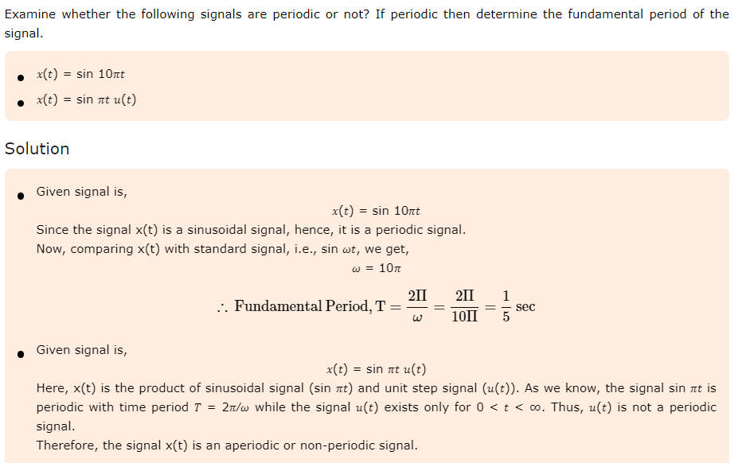
Example

Slide 10
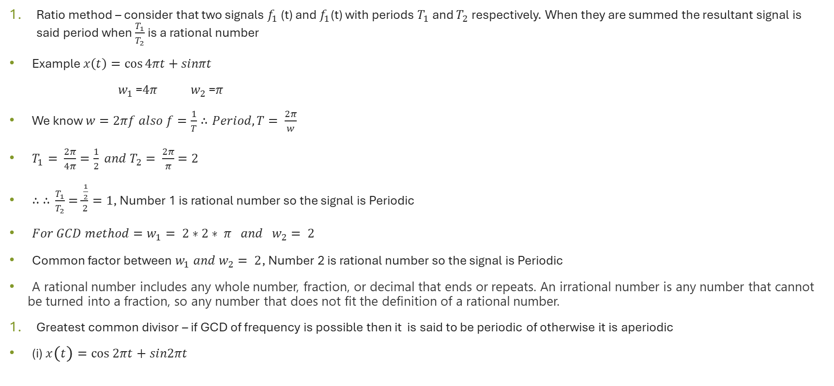
How to test for periodicity of a signal
Ratio method – consider that two signals $f_{1}$ (t) and $f_{1}$(t) with periods $T_{1}$ and $T_{2}$ respectively. When they are summed the resultant signal is said period when $\frac{T_{1}}{T_{2}}$ is a rational number
Example $x\left(t\right)=\cos{4πt}+sinπt$
$w_{1}$ =$4π$ $w_{2}$ =$π$
We know $w=2πf also f=\frac{1}{T}∴Period, T= \frac{2π}{w}$
$T_{1}= \frac{2π}{4π}=\frac{1}{2} and T_{2}= \frac{2π}{π}=2$
$∴ ∴$ $\frac{T_{1}}{T_{2}}=\frac{\frac{1}{2}}{2}=1$, Number 1 is rational number so the signal is Periodic
$For GCD method=w_{1}= 2∗2∗ π and w_{2}= 2$
Common factor between $w_{1} and w_{2}= 2$, Number 2 is rational number so the signal is Periodic
A rational number includes any whole number, fraction, or decimal that ends or repeats. An irrational number is any number that cannot be turned into a fraction, so any number that does not fit the definition of a rational number.
Greatest common divisor – if GCD of frequency is possible then it is said to be periodic of otherwise it is aperiodic
(i) $x\left(t\right)=\cos{2πt}+sin2πt$

Slide 11
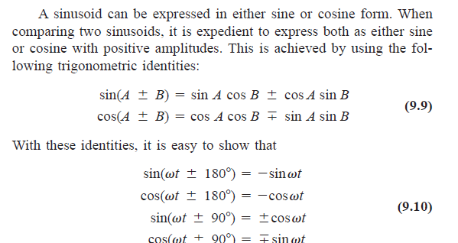
Application of Trigonometry to Signals

Slide 12
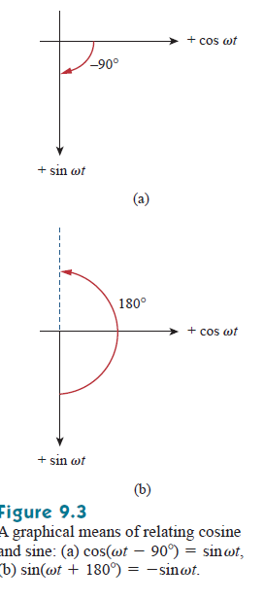
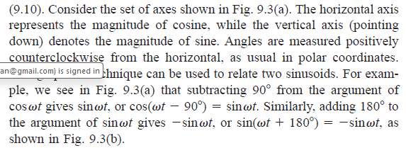

Slide 13
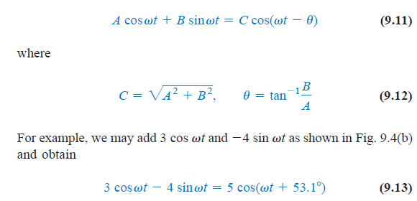

Slide 14
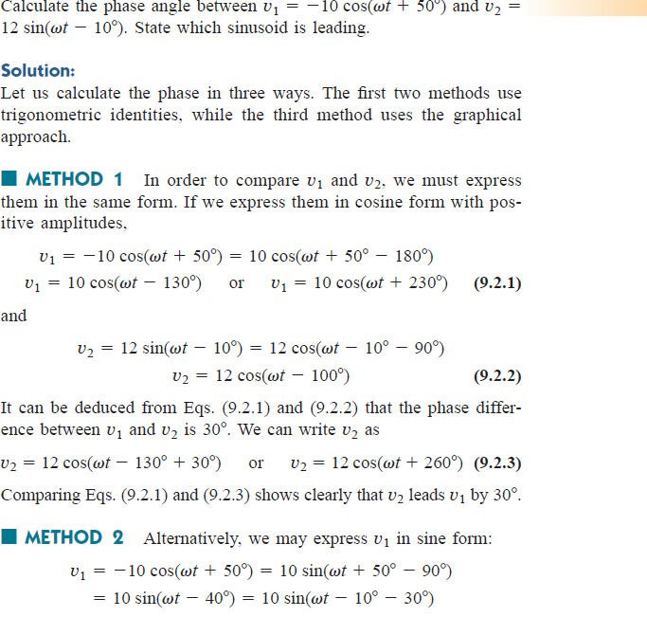

Slide 15
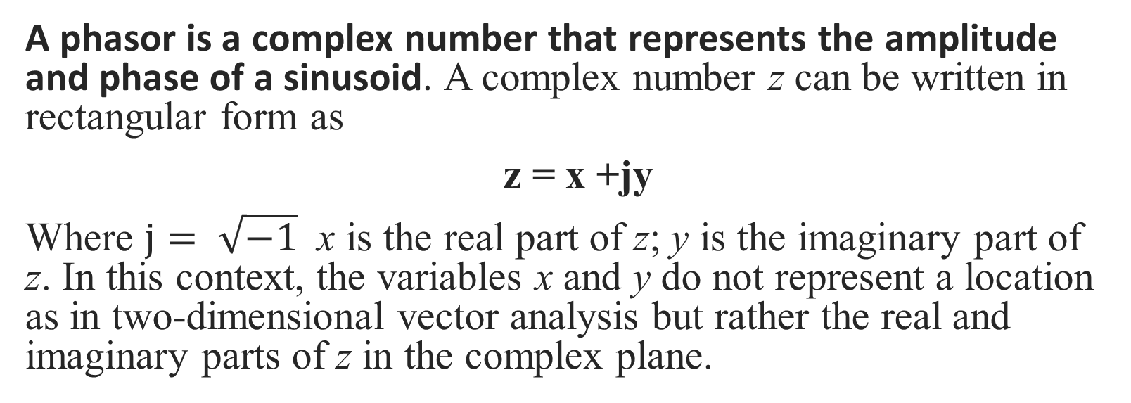
Phasor
A phasor is a complex number that represents the amplitude and phase of a sinusoid. A complex number z can be written in rectangular form as
z = x +jy
Where $j= \sqrt{−1}$ x is the real part of z; y is the imaginary part of z. In this context, the variables x and y do not represent a location as in two-dimensional vector analysis but rather the real and imaginary parts of z in the complex plane.

Slide 16
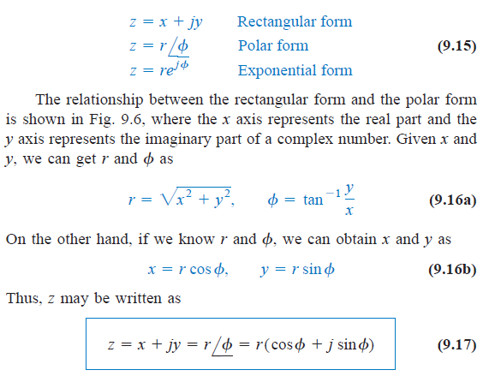
Phasor

Slide 17
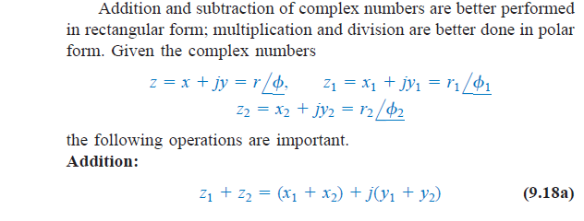
Phasor

Slide 18
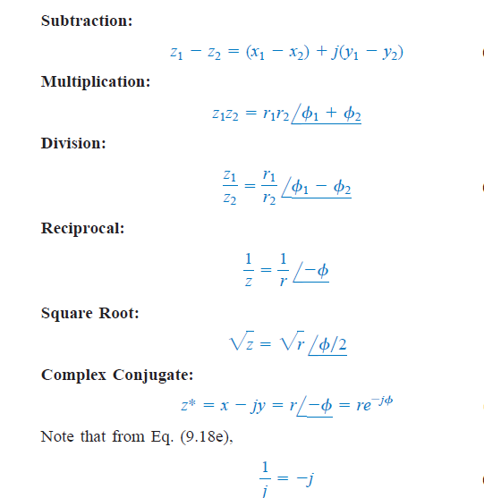
Phasor

Slide 19
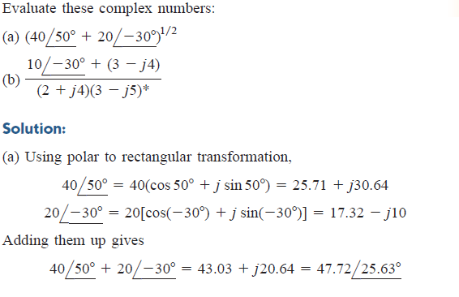
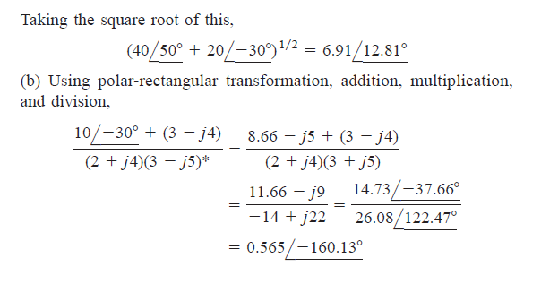
Phasor

Slide 20
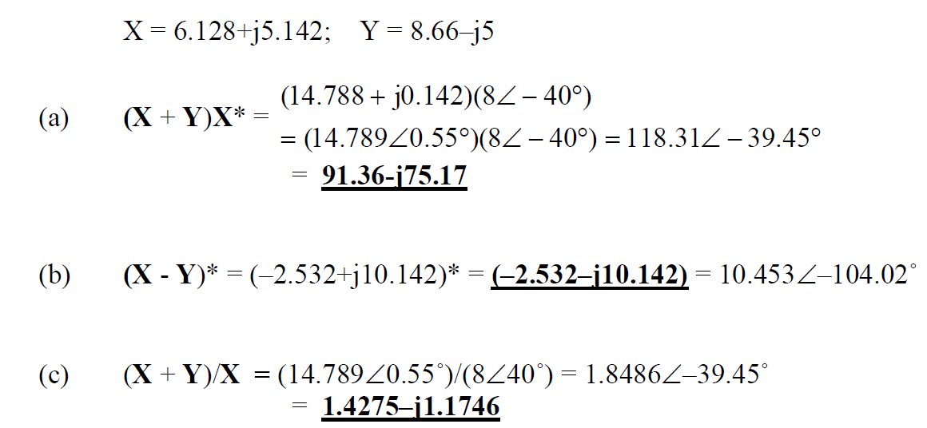

Phasor
Question
Let $X=8<{40}^{∘}$ and $Y=10<−{30}^{∘}$ Evaluate the following quantities and express your results in polar form (i) ${\left(X+Y\right)X}^{∗}$(ii) ${\left(X−Y\right)}^{∗}$(iii) ${\left(X+Y\right)/X}^{}$
Answer: x= 8(cos40+jsin40) = 6.128+j5.142 and y= 10(cos-30 + jsin -30) = 8.66 –j5

Slide 21
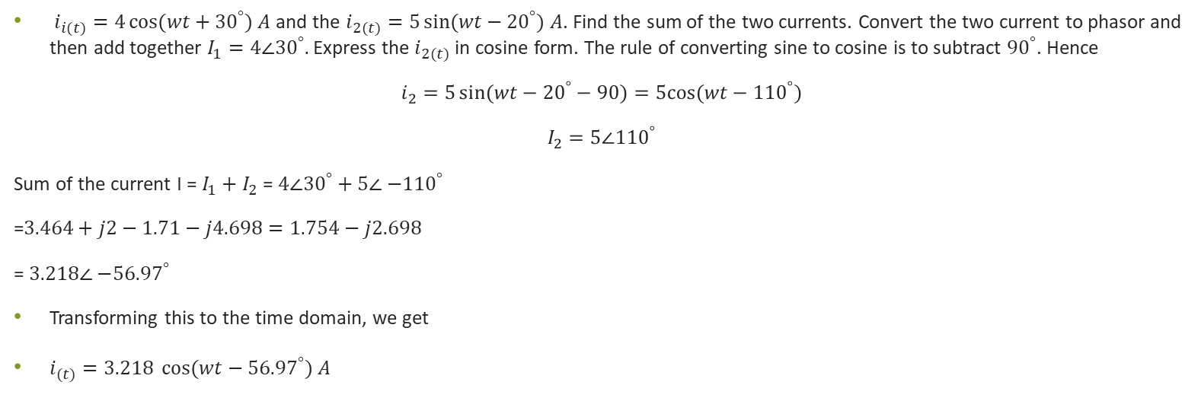
Example
$i_{i(t)}=4\cos{(wt}+{30}^{°}) A$ and the $i_{2(t)}=5\sin{(wt}−{20}^{°}) A$. Find the sum of the two currents. Convert the two current to phasor and then add together $I_{1}=4∠{30}^{°}.$Express the $i_{2(t)}$ in cosine form. The rule of converting sine to cosine is to subtract ${90}^{°}$. Hence
$$i_{2}=5\sin{(wt}−{20}^{°}−90)=5cos⁡(wt−{110}^{°})$$
$$I_{2}=5∠{110}^{°}$$
Sum of the current I = $I_{1}+I_{2}$ = $4∠{30}^{°}+$ $5∠{−110}^{°}$
=$3.464+j2−1.71−j4.698=1.754−j2.698$
= $3.218∠{−56.97}^{°}$
Transforming this to the time domain, we get
$i_{(t)}=3.218 \cos{(wt}−{56.97}^{°}) A$

Slide 22
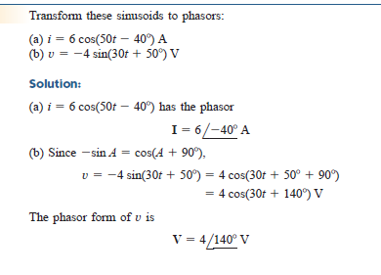
Example

Slide 23

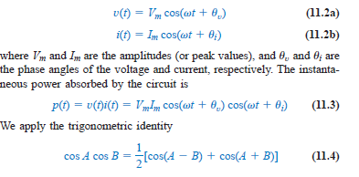
AC POWER ANALYSIS: INSTANTANEOUS
the instantaneous power p(t) absorbed by an element is the product of the instantaneous voltage v(t) across the element and the instantaneous current i(t) through it. Assuming the passive sign convention,
The instantaneous power (in watts) is the power at any instant of time. It is the rate at which an element absorbs energy. Let the voltage and current at the terminals of
the circuit be

Slide 24

AC POWER ANALYSIS: INSTANTANEOUS
This shows us that the instantaneous power has two parts. The first part is constant or time independent. Its value depends on the phase difference between the voltage and the current. The second part is a sinusoidal function whose frequency is which is 2w twice the angular frequency of the voltage or current.

Slide 25


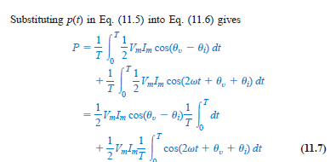
AVERAGE POWER
The average power, in watts, is the average of the instantaneous power over one period.

Slide 26
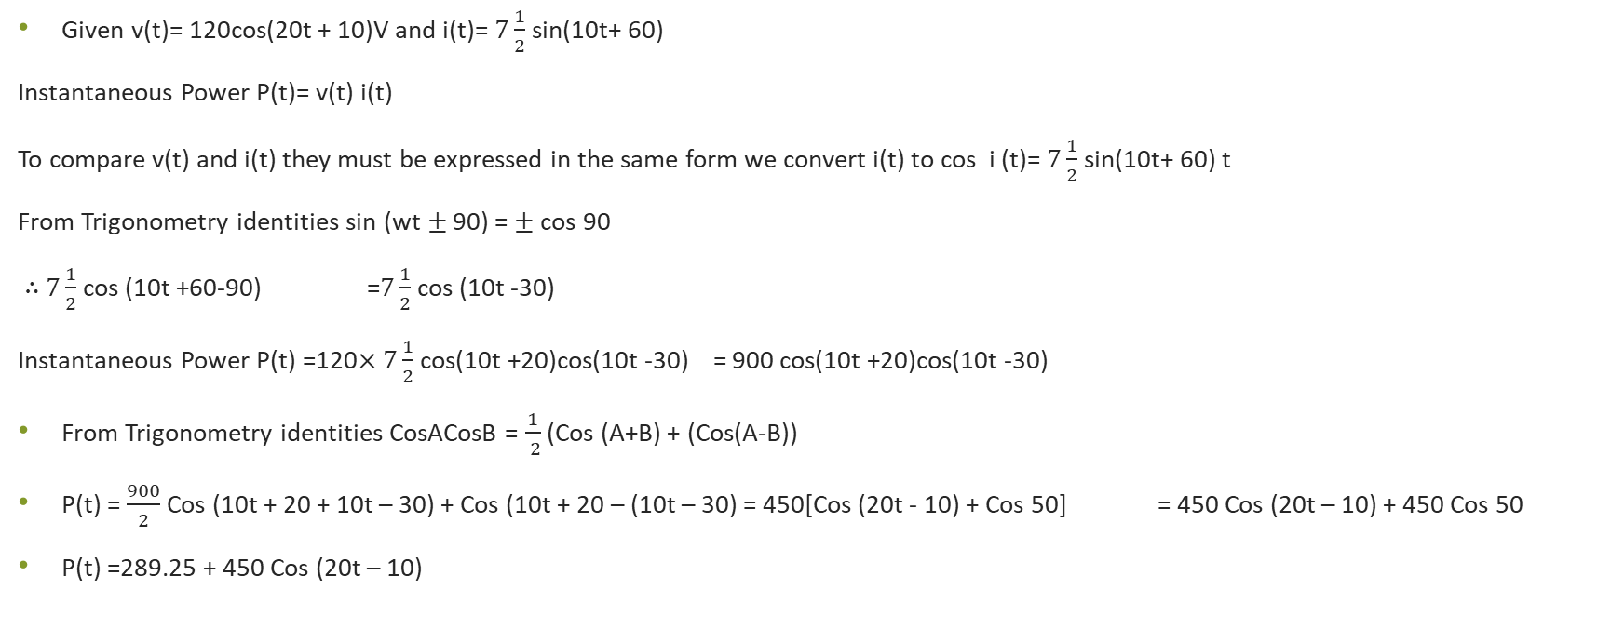
Example
Given v(t)= 120cos(20t + 10)V and i(t)= $7\frac{1}{2}$sin(10t+ 60)
Instantaneous Power P(t)= v(t) i(t)
To compare v(t) and i(t) they must be expressed in the same form we convert i(t) to cos i (t)= $7\frac{1}{2}$sin(10t+ 60) t
From Trigonometry identities sin (wt$±$ 90) = $±$ cos 90
$∴$ $7\frac{1}{2}$ cos (10t +60-90) =$7\frac{1}{2}$ cos (10t -30)
Instantaneous Power P(t) =120$×7\frac{1}{2}$ cos(10t +20)cos(10t -30) = 900 cos(10t +20)cos(10t -30)
From Trigonometry identities CosACosB = $\frac{1}{ 2}$ (Cos (A+B) + (Cos(A-B))
P(t) = $\frac{900}{2}$ Cos (10t + 20 + 10t – 30) + Cos (10t + 20 – (10t – 30) = 450[Cos (20t - 10) + Cos 50] = 450 Cos (20t – 10) + 450 Cos 50
P(t) =289.25 + 450 Cos (20t – 10)

Slide 27

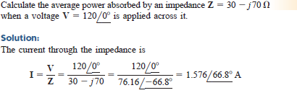
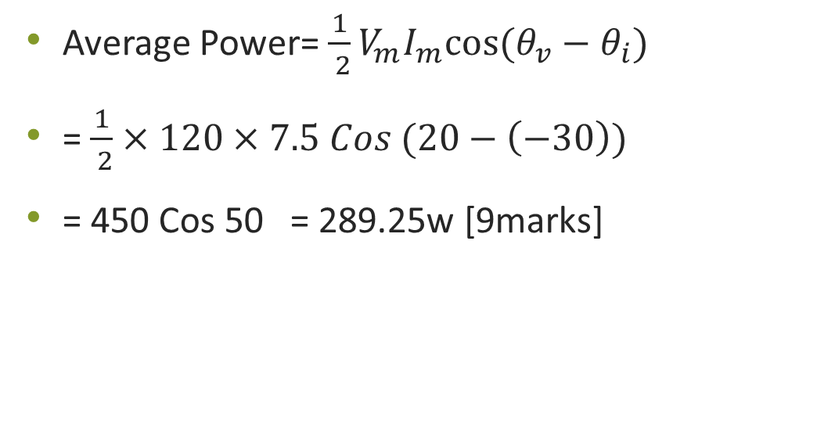
Example (cont’d)
Average Power= $\frac{1}{ 2}V_{m}I_{m}cos⁡(θ_{v}−θ_{i})$
= $\frac{1}{ 2}×120×7.5 Cos (20−\left(−30\right))$
= 450 Cos 50 = 289.25w [9marks]

Slide 28
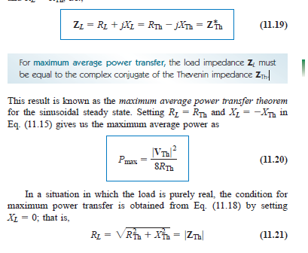
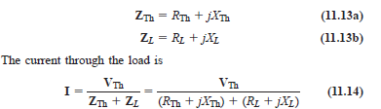
MAXIMUM AVERAGE POWER TRANSFER
For maximum average power transfer, the load impedance ZL must be equal to the complex conjugate of the Thevenin impedance ZTh.

Slide 29
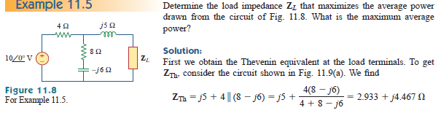
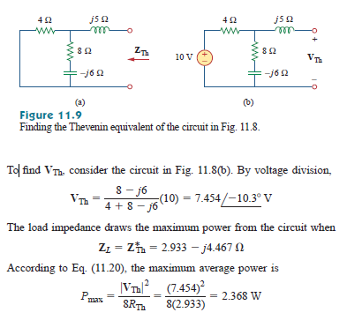

Slide 30
Example
In Figure 1, the resistor R_{L} is adjusted until it absorbs the maximum average power. Calculate R_{L} and the maximum average power absorbed by it. [10marks]
Question: The resistor R_{L} is adjusted until it absorbs the maximum average power. Calculate R_{L} and the maximum average power absorbed by it.

Slide 31
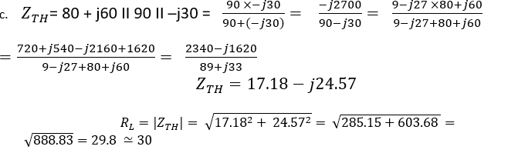

Slide 32
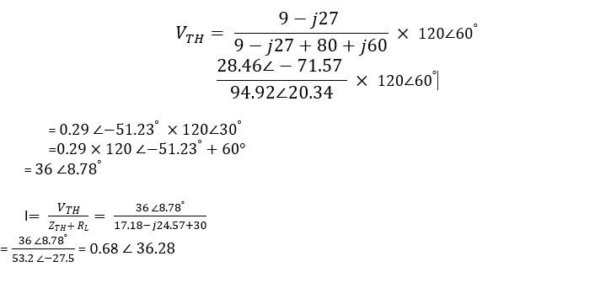
Example (Cont’d)

Slide 33
EFFECTIVE OR RMS VALUE
The idea of effective value arises from the need to measure the effectiveness of a voltage or current source in delivering power to a resistive load.
The effective value of a periodic current is the dc current that delivers the same average power to a resistor as the periodic current.

Slide 34
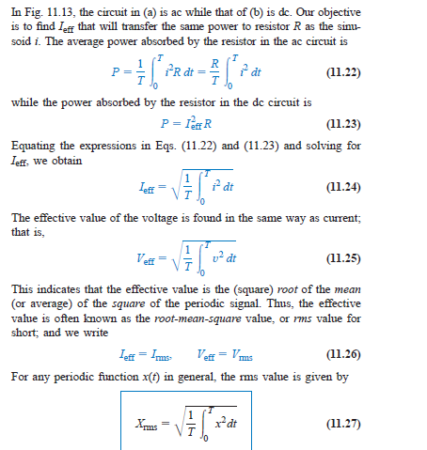
EFFECTIVE OR RMS VALUE

Slide 35
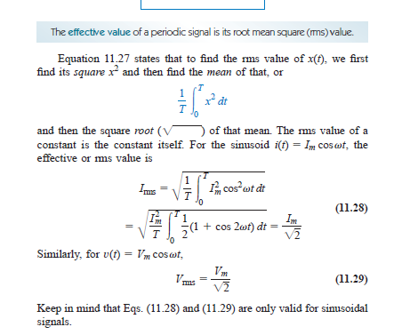
EFFECTIVE OR RMS VALUE

Slide 36
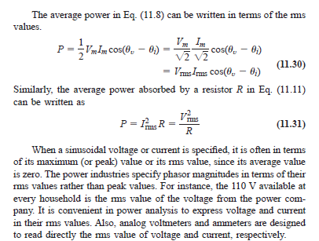
EFFECTIVE OR RMS VALUE

Slide 37
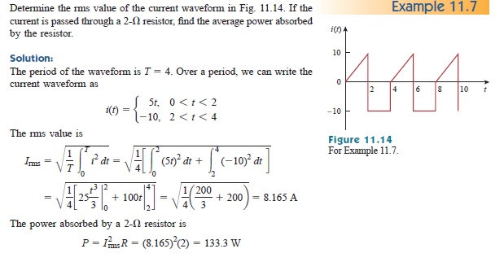
Example

Slide 38
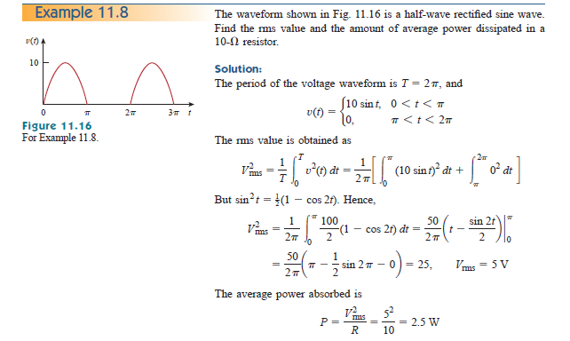
Example

Slide 39
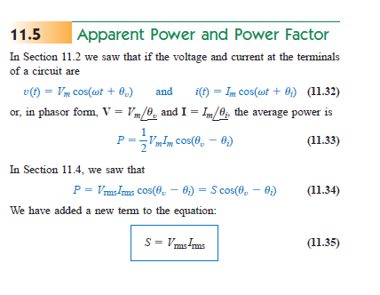
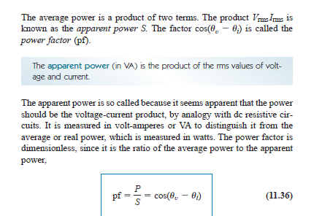
Apparent Power and Power Factor

Slide 40
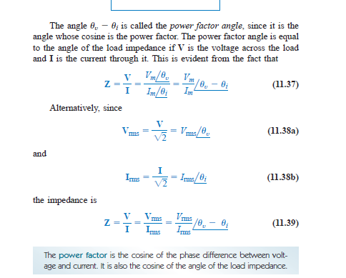
Power Factor

Slide 41
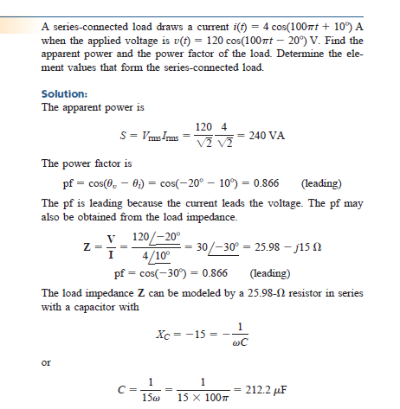
Example

Slide 42
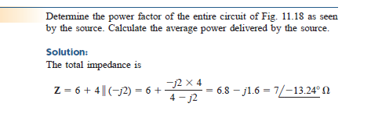
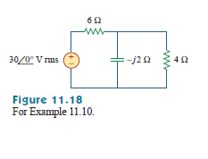
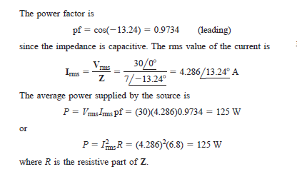
Example

Slide 43
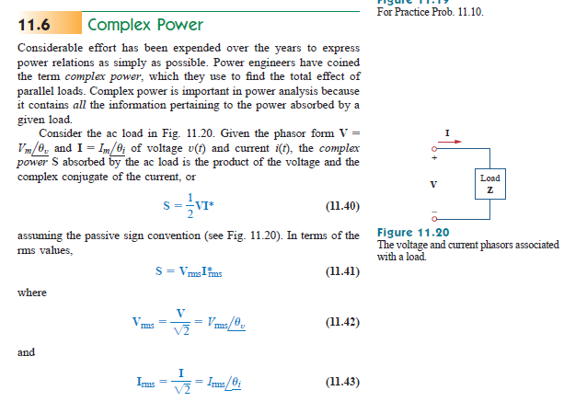
Complex Power

Slide 44
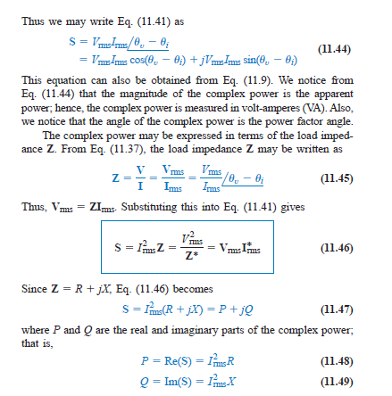
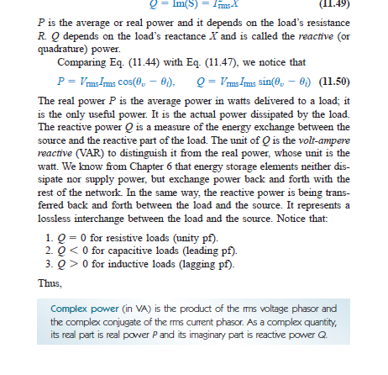
Complex Power

Slide 45


Example

Slide 46

Example

Slide 47


Power Factor Correction
The process of increasing the power factor without altering the voltage or current to the original load is known as power factor correction.

